Slide 1
Bitcoin NFTs & Ordinal Protocols
By: Rana Ahsan Ansar
GitHub Respository for my Blockchain Training: https://github.com/ranaahsanansar/BlcokchainTraning

Slide 2
Introduction to Ordinals Protocol
BTC Ordinals were introduced as a method of generating Bitcoin NFTs by attaching information to individual satoshi.
Ordinal inscriptions are digital assets, similar to NFTs, inscribed on a satoshi in the Bitcoin network. All this data in minted on blockchain. This process has been made possible because of Taproot soft fork launched on November 14, 2021. Ordinal protocol allows the tracking and transfer of individual satoshis using ordinal wallet.
Ordinals Protocol is a system, In which each satoshi is linked by a serial number, it allow users to make individual satoshi unique by attaching extra data to them. This process is known as “Inscription”.

Slide 3
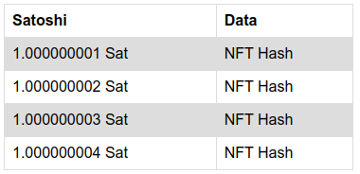
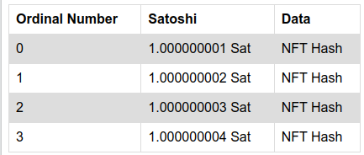
Explaination dy giving an example
Amuse that we have a table without serial number represent data coming from node
After applying ordinal protocol each satoshi is represent by a unique primary key.

Slide 4
Representations of Ordinal Numbers
Ordinal numbers have a few different representations:
Integer notation: 2099994106992659 The ordinal number, assigned according to the order in which the satoshi was mined.
Decimal notation: 3891094.16797 The first number is the block height in which the satoshi was mined, the second the offset of the satoshi within the block.
Degree notation: 3°111094′214″16797‴. We'll get to that in a moment
Percentile notation: 99.99971949060254% . The satoshi’s position in Bitcoin's supply, expressed as a percentage.
Name: satoshi. An encoding of the ordinal number using the characters a through z.

Slide 5
Methods to create Ordinal inscriptions
By using Ordinal-compatible wallets or online services. For example: Ordinals Wallet, Unisat wallet and Gama service.
By running a full node and ord server in your system.

Slide 6
Steps for creating ordinal inscription using BTC full node
Install bitcoin core.
Sync the Bitcoin node with main net.
Install ord server.
Sync the Ord server with Bitcoin node.
Create bitcoin ordinal wallet
Create your Inscriptions using cli command.

Slide 7
Installation of Bitcoin node
There are two method to run a bitcoin node in to your system.
Using Bitcoin Core (User interface Client)
Using HomeBrew tool. (Command Line interface)
Brew is used to install and start bitcoin node. It automatically install all the required dependencies.

Slide 8


Step for Installing Bitcoin using Brew
Install Homebrew by using command available on http://brew.sh
Install bitcoin using “brew install bitcoin”
Start bitcoin node using “brew services start bitcoin”
Check Node is running or not using bitcoin-cli getblockcount

Slide 9
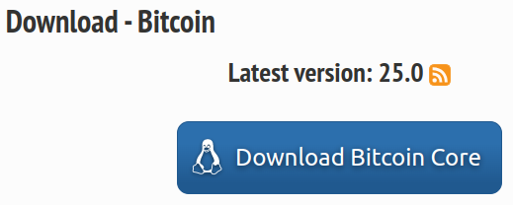
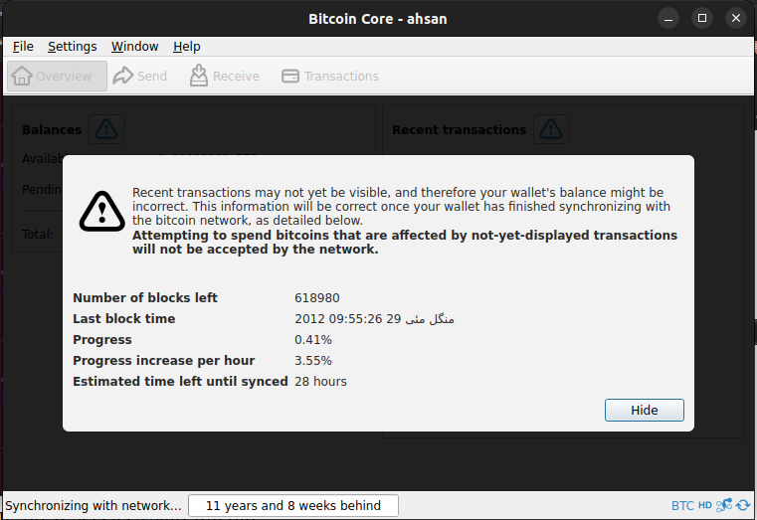
Step for Installing Bitcoin Core (Client)
Go to the https://bitcoincore.org/en/download/
Install latest version.
Run the Bitcoin core client.

Slide 10
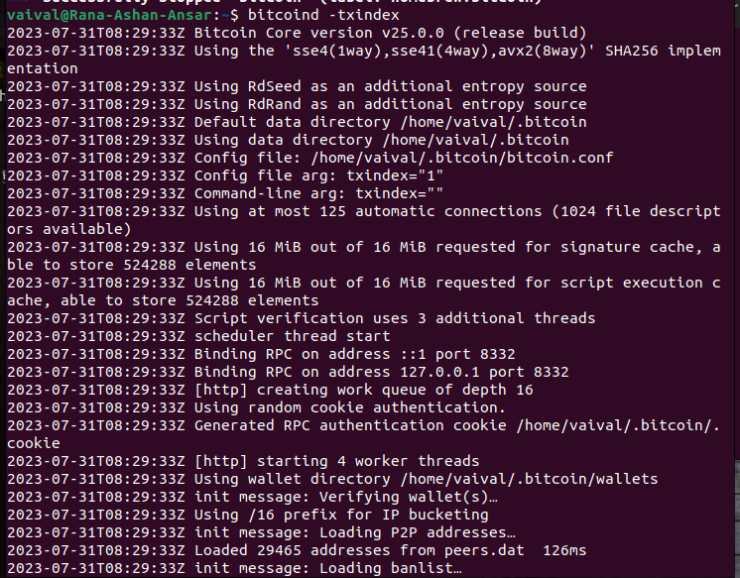
Sync the node with Ord indexes
ord requires Bitcoin Core's transaction index.
To configure your Bitcoin Core node to maintain a transaction index, run this command “ bitcoind -txindex ”

Slide 11
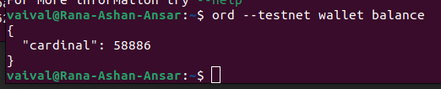
Next steps after running and syncing Bitcoin
Install cargo with rust
Install ord using cargo “ cargo install ord ”
Now, create a new ord wallet using “ord wallet create”
Now, check ord wallet balance, It will automatically sync blocks with ordinal numbers.

Slide 12
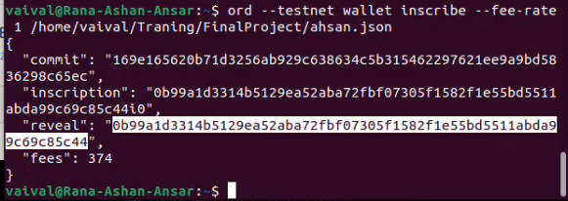
Continue
Create Bitcoin core wallet using “ord wallet create”
Send some bicoins in ord wallet.
Create Inscriptions using
“ord wallet inscribe --fee-rate FEE_RATE FILE”

Slide 13
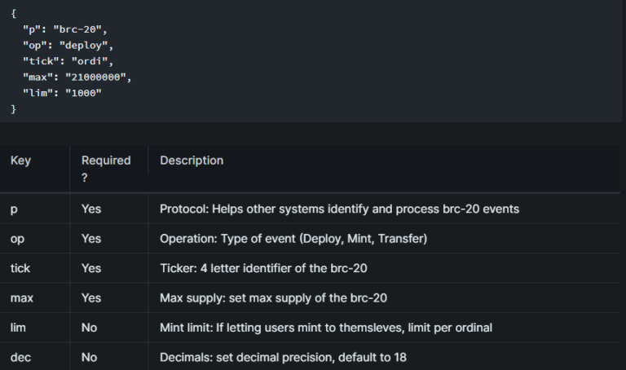
Deploying BRC-20
BRC-20 tokens use same process of “inscription” to add a short piece of JSON code to create tokens.

Slide 14
Deploying BRC-20
Deploy a Token Contract. The BRC-20 token contract is a JSON file that defines the four-letter name, maximum supply, decimals and mint limit. You can deploy your token by inscribing the JSON file onto a satoshi using a wallet that supports ordinals and inscriptions. This creates the first set of tokens of your BRC-20 token and assigns it to your wallet address.
Mint More Tokens. To mint more of your new BRC-20 token, you can inscribe another JSON file onto another satoshi using the same process. The JSON file will be slightly shorter since you don’t have to specify the same information from the initial deployment.
Transfer Tokens. To transfer tokens of your BRC-20 token to another wallet address, the inscription process is the same as above. This JSON file should contain the number of tokens you want to transfer, the name of the token contract you deployed in the first step and the recipient’s address. This should decrease the balance of your wallet address and increase the balance of the recipient’s wallet address.
Source: https://investorplace.com/2023/05/brc-20-tokens-the-investors-guide-to-cryptos-latest-craze

Slide 15
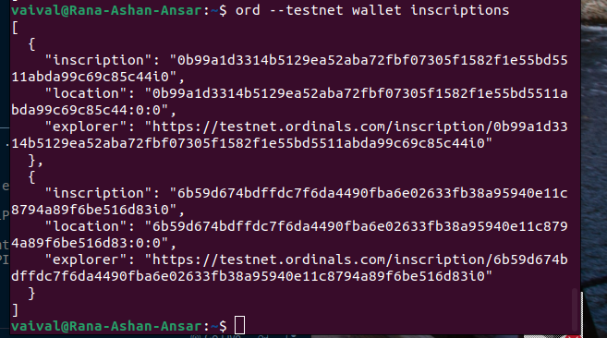
Continue
Here is screen short of my minted Inscription on bitcoin testnet.

Slide 16
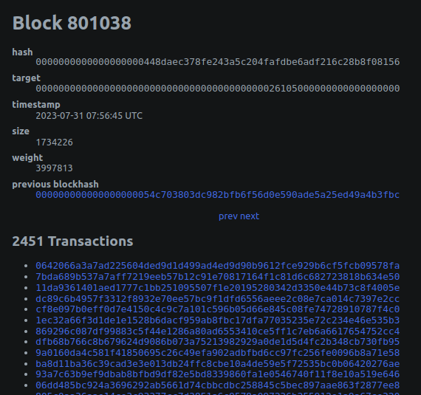
Ordinal Explorer
Now you can track you inscription using Ordinal Block explorer

Slide 17
Bitcoin validation node API
Bitcoin-core allow us to create API using “bitcoin-core” library. Using this API we can create our own block explorer.
Before building API we need to add a configuration file ( bitcoin.conf ) in Bitcoin directory and declare RPC User and RPC password in it. e.g. ( -rpcuser=”NAME” -rpcpassword=”12345678” )
At a same time we can use only one wallet to fetch data from BTC node.
I push my example API in Final project directory on git-hub.
Git-repository: https://github.com/ranaahsanansar/BlcokchainTraning

